Slide 1
Basic AngularJs
Tasnim Reza
Git: https://github.com/tasnim-reza/angularjs-class

Slide 2
Agenda
Browser Basic
DOM
What is AngularJs
Demo
Handle a Form using jQuery
Handle a Form using AngularJs

Slide 3
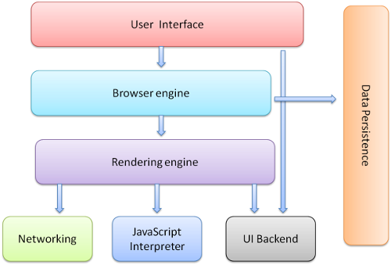
Browser Basic
http://www.html5rocks.com/en/tutorials/internals/howbrowserswork/

Slide 4
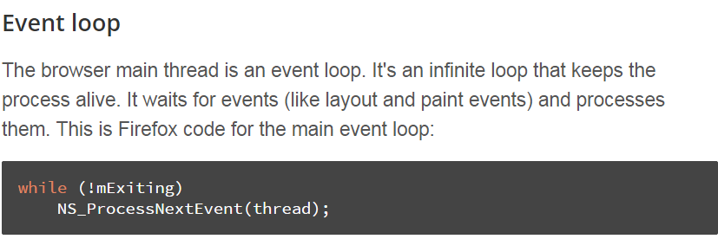
Browser Basic
Rendering Engine
Single threaded
Network operation multiple thread
Event Loop

Slide 5
Browser Basic
JavaScript Engine
V8 - open source, developed by Google in Denmark, part of Google Chrome
Chakra, for Internet Explorer 9^{[16]}
Rhino, Spidermonkey used by Firefox
JavaScriptCore for Apple, Safari

Slide 6
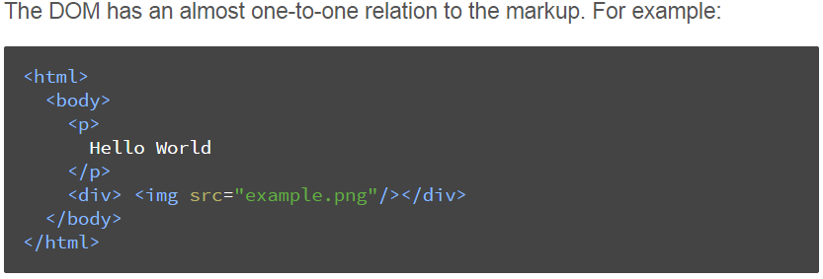
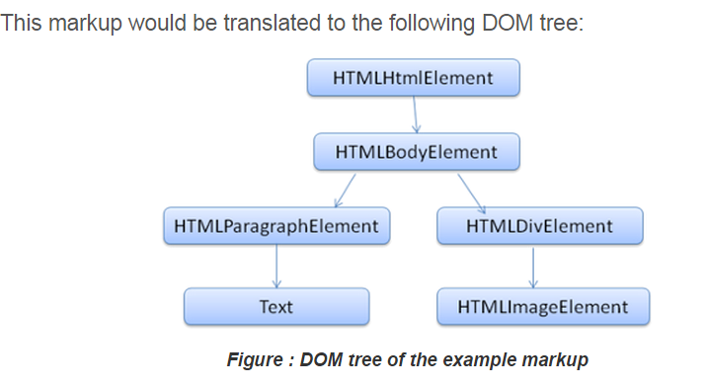
DOM

Slide 7
DOM
Document Object Model
Web browsers rely on layout engines to parse HTML into a DOM
It is the object presentation of the HTML document
The root of the tree is the "Document" object.

Slide 8
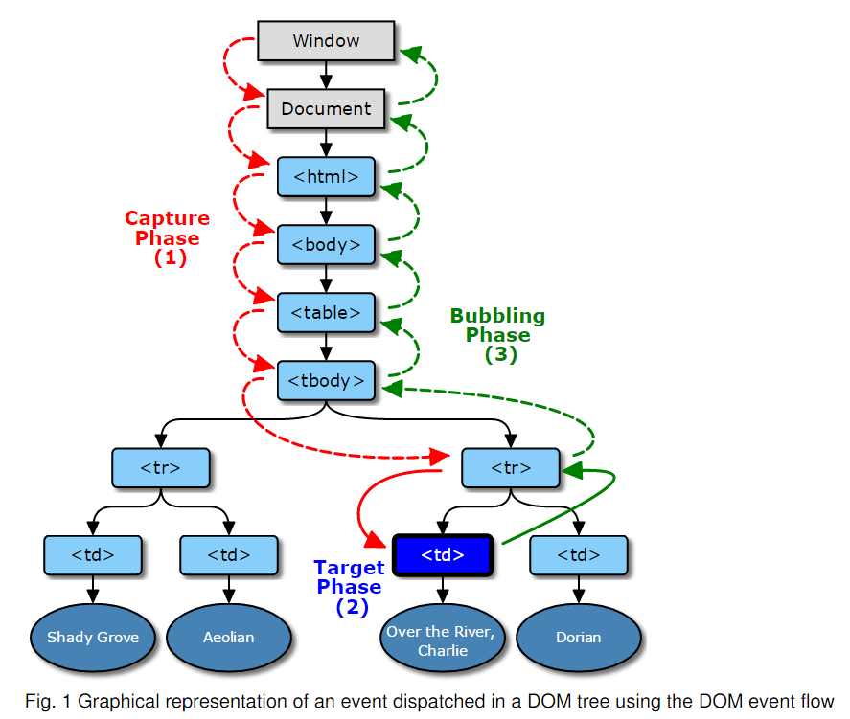
DOM Event
http://www.w3.org/TR/DOM-Level-3-Events/#dom-event-architecture

Slide 9
DOM Event
var e = document.createEvent("Event");
e.initEvent("myevent", false, false);
var target = document.createElement("div");
target.addEventListener("myevent", function () {
throw "Error";
});
target.dispatchEvent(e); // Causes the event listener to throw an exception...
// The previously thrown exception doesn't affect the code that follows:
console.log("Exceptions? No problem");
http://www.w3.org/TR/DOM-Level-3-Events/#dom-event-architecture

Slide 10
Think in AngularJs !
AngularJs is a Framework and Library also.
Architect your application instead of design a page
Don’t augment jQuery with AngularJs
Always think in terms of Architecture
What is Single Page Application ?
This is application not just bunch of web pages !!
http://stackoverflow.com/questions/14994391/thinking-in-angularjs-if-i-have-a-jquery-background?lq=1

Slide 11
Think in AngularJs !
Look at the view
In jQuery
<ul class="main-menu">
<li class="active">
<a href="#/home">Home</a>
</li>
<ul>
$('.main-menu').dropdownMenu();

Slide 12
Think in AngularJs !
In AngularJs
<ul class="main-menu" dropdown-menu> ... </ul>
This is called Declarative approach
Here ‘dropdown-menu’ is Directive
Directive
This is place where you can manipulate your Markup.
Remember: don't design, and then mark up. You must architect, and then design.

Slide 13
Think in AngularJs !
Data Binding
In jQuery
<input id="username">
$('.username').val('Reza')
In AngularJs
<input id="username" ng-model="username">
$scope.username = 'Reza';
Distinct model layer

Slide 14
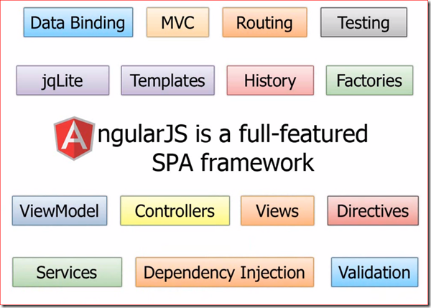
What is Angular anyway ?

Slide 15
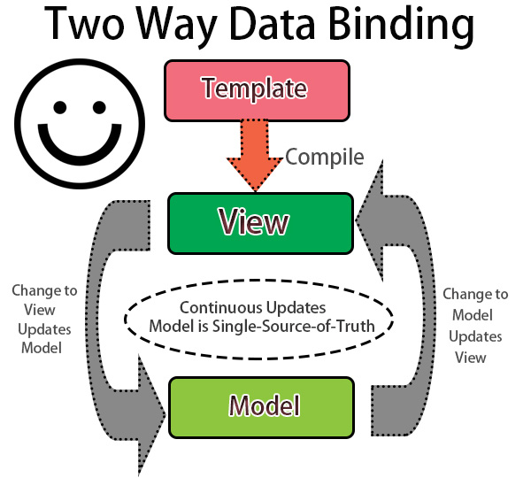
AngularJs component
Data Binding

Slide 16
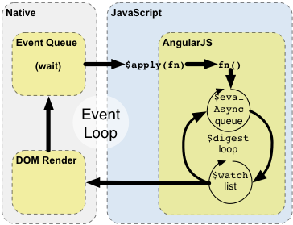
AngularJs component
Data Binding Under the hood
Notes:
The browser's event-loop waits for an event to arrive. The event's callback gets executed... Once the callback executes, the browser leaves the JavaScript context and re-renders the view based on DOM changes. Angular modifies the normal JavaScript flow by providing its own event processing loop. This splits the JavaScript into classical and Angular execution context... Angular executes [some] stimulusFn(), which typically modifies application state. Angular enters the $digest loop. The loop is made up of two smaller loops which process $evalAsync queue and the $watch list. The $digest loop keeps iterating until the model stabilizes, which means that the $evalAsync queue is empty and the $watch list does not detect any changes. The $watch list is a set of expressions which may have changed since last iteration. If a change is detected then the $watch function is called which typically updates the DOM with the new value.

Slide 17
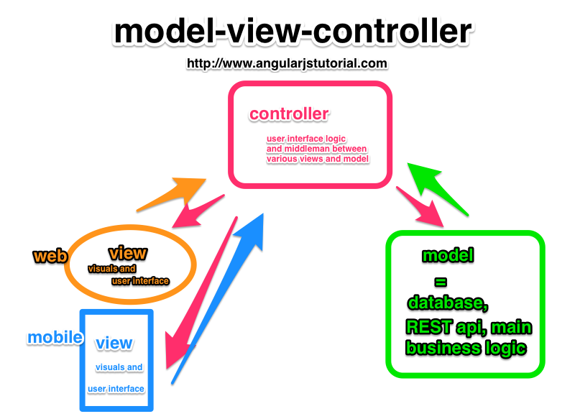
AngularJs component
MVC

Slide 18
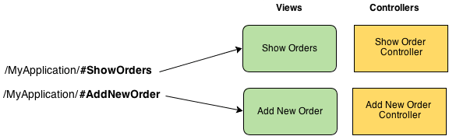
AngularJs component
Routing

Slide 19
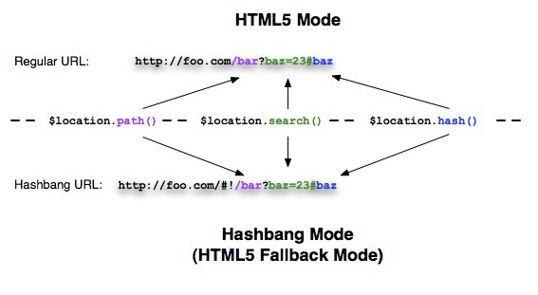
AngularJs component
Routing

Slide 20
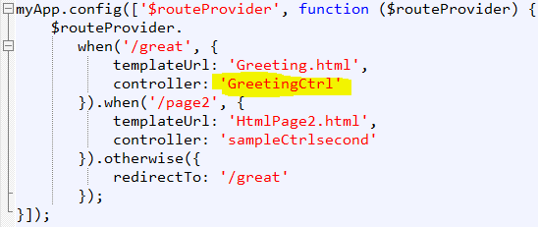
AngularJs component
Routing

Slide 21
AngularJs component
Browser History
Browser automatically handle url based routing
$location is used for parses the URL in the browser
jQLite
angular.element return jQuery object

Slide 22
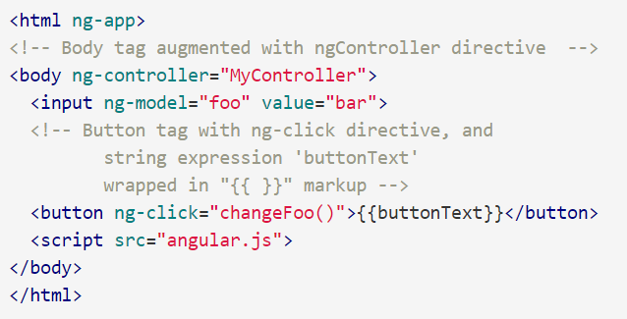
AngularJs component
AngularJs Template
In a simple app, the template consists of HTML, CSS, and Angular directives contained in just one HTML file (usually index.html).

Slide 23
AngularJs component
Services
Lazily instantiated
Singletons
Types
Factories
Value
Constant
Service
Provider

Slide 24
AngularJs component
View Model
Distinct model layer
scope is an object that refers to the application model
$scope.countries = ['can', 'usa', 'fra', 'jap'];
$scope.user = {name: "Evil Trout"};

Slide 25
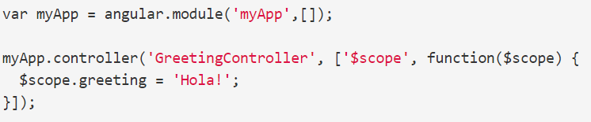
AngularJs component
Controlers
A Controller is a JavaScript constructor function that is used to augment the Angular Scope
A Controller is attached to the DOM via the ng-controller directive

Slide 26
AngularJs component
Use controllers to:
Set up the initial state of the $scope object.
Add behavior to the $scope object.
Do not use controllers to:
Manipulate DOM
Format input — Use angular form controls instead.
Filter output — Use angular filters instead.
Share code or state across controllers — Use angular services instead.
Manage the life-cycle of other components (for example, to create service instances).

Slide 27
AngularJs component
Directives
Directives are markers on a DOM element (such as an attribute, element name, comment or CSS class) that tell AngularJS'sHTML compiler ($compile) to attach a specified behavior to that DOM element or even transform the DOM element and its children.
<input ng-model="foo">
<input data-ng:model="foo">

Slide 28



AngularJs component
Filters
A filter formats the value of an expression for display to the user

Slide 29
AngularJs component
Validation
Form directive

Slide 30
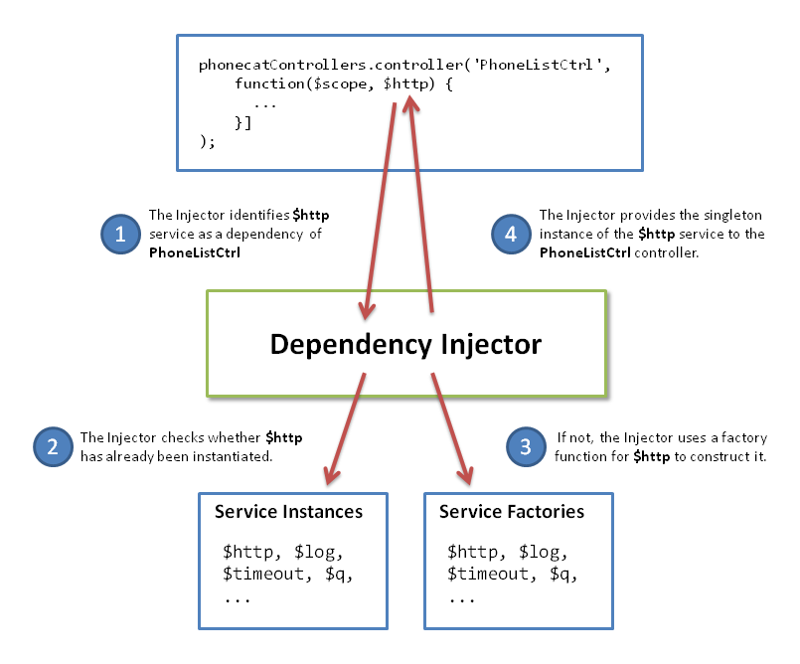
AngularJs component
DI

Slide 31
AngularJs component
Testing
‘JavaScript is a dynamically typed language which comes with great power of expression, but it also comes with almost no help from the compiler. For this reason we feel very strongly that any code written in JavaScript needs to come with a strong set of tests. We have built many features into Angular which makes testing your Angular applications easy. So there is no excuse for not testing’

Slide 32
AngularJs component
Unit Testing
Assert JS object
E2E Testing
Assert HTML attribute, value, style

Slide 33
AngularJs Working Process

Slide 34
AngularJs Working Process
Compilation Phase
the ng-model and input directive set up a keydown listener on the <input> control
the interpolation sets up a $watch to be notified of name changes.
Runtime Phase
Pressing an 'X' key causes the browser to emit a keydown event on the input control.

Slide 35
AngularJs Working Process
The input directive captures the change to the input's value and calls $apply("name = 'X';")to update the application model inside the Angular execution context.
Angular applies the name = 'X'; to the model.
The $digest loop begins
The $watch list detects a change on the name property and notifies the interpolation, which in turn updates the DOM.

Slide 36
AngularJs Working Process
Angular exits the execution context, which in turn exits the keydown event and with it the JavaScript execution context.
The browser re-renders the view with update text.

Slide 37


